Slide 1

Algorithms and Data Structures 1 CS 0445
Fall 2023
String Matching
Sherif Khattab
ksm73@pitt.edu
(Slides adapted from slides of Textbook, Dr. Ramirez’s CS 0445, and Dr. Farnan’s CS 1501)

Slide 2
Announcements
Upcoming Deadlines
Homework 11: Tuesday 12/5 @ 11:59 pm
Assignment 5: Friday 12/8 @ 11:59 pm
Homework 12: Tuesday 12/12 @ 11:59 pm

Slide 3
Final Exam
Friday 12/15 noon-1:50 pm
Same format as midterm
Non-cumulative
Same classroom as lectures
Study guide and practice test on Canvas
Final Review in this week’s recitations

Slide 4
Bonus Opportunities
Bonus Lab: Monday 12/18 @ 11:59 pm – up to 1%
Bonus Homework: 12/18 @ 11:59 pm – up to 0.5%
OMETs Bonus: 1% for entire class
when OMETs response rate >= 80%
Currently at 11%
Deadline is Sunday 12/10

Slide 5
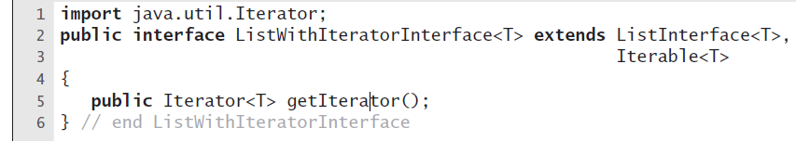
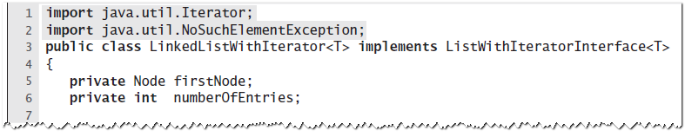
Iterator Implementation as Inner Class

Slide 6
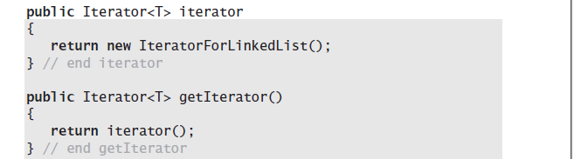
Iterator for LinkedList

Slide 7
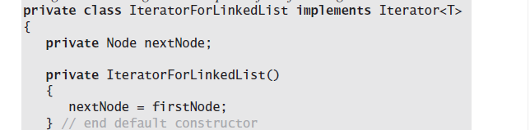
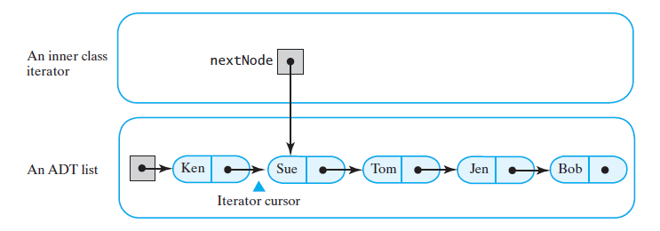
Iterator for Linked List

Slide 8
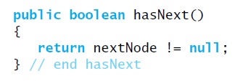
hasNext

Slide 9
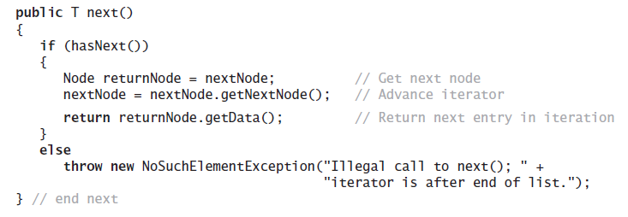
next

Slide 10
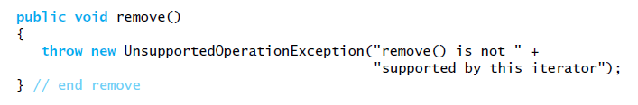
remove

Slide 11
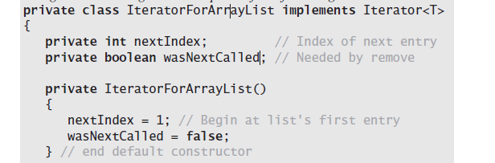
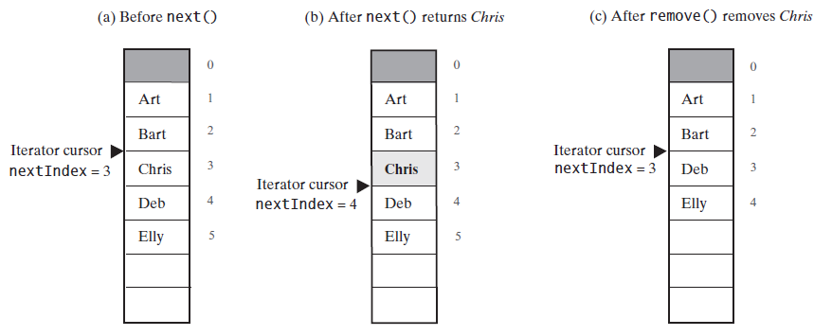
Iterator for Array List

Slide 12
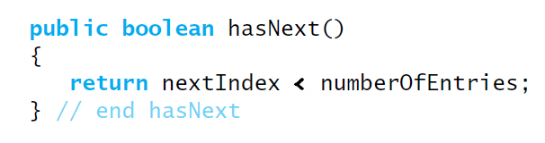
hasNext

Slide 13
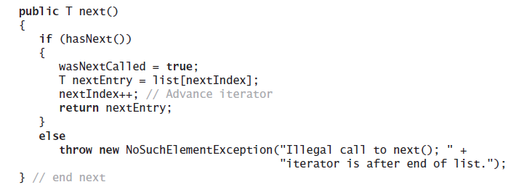
next

Slide 14
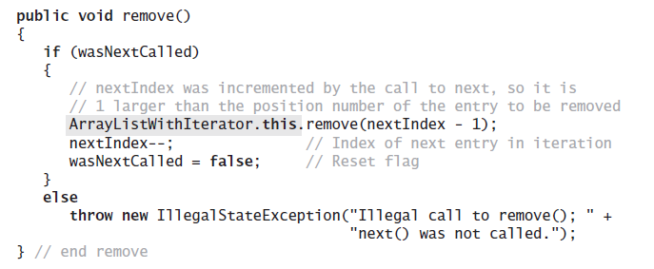
remove

Slide 15
Iterable vs. Iterator Interfaces
Iterator → implement iterators
Iterable → implement containers that have iterators
allows us to use the for-each loop structure
IterableLinkedList<Integer> list = new …..
for(Integer x : list){
//do something with x
}

Slide 16
String Matching
Have a pattern string p of length m
Have a text string t of length n
Can we find an index i of string t such that each of the m characters in the substring of t starting at i matches each character in p
Example: can we find the pattern "fox" in the text "the quick brown fox jumps over the lazy dog"?
Yes! At index 16 of the text string!

Slide 17
Simple approach
BRUTE FORCE
Start at the beginning of both pattern and text
Compare characters left to right
Mismatch?
Start again at the 2nd character of the text and the beginning of the pattern...

Slide 18
Brute force code
public static int bf_search(String pat, String txt) {
int m = pat.length();
int n = txt.length();
for (int i = 0; i <= n - m; i++) {
int j;
for (j = 0; j < m; j++) {
if (txt.charAt(i + j) != pat.charAt(j))
break;
}
if (j == m)
return i; // found at offset i
}
return n; // not found
}

Slide 19
Brute force Algorithm

Slide 20
i: | 0
text: | A | B | A | B | A | B | A | C
pattern: | A | B | A | B | A | C
j: | 0
public static int bf_search(String pat, String txt) {
int j, m = pat.length();
int i, n = txt.length();
for (i = 0, j = 0; i <= n – m && j < m; i++) {
if (txt.charAt(i) == pat.charAt(j))
j++;
else { i -= j; j = 0; }
}
if (j == m)
return i - m; // found at offset i
else return n; // not found
}

Slide 21
i: | 0 | 1
text: | A | B | A | B | A | B | A | C
pattern: | A | B | A | B | A | C
j: | 0 | 1
public static int bf_search(String pat, String txt) {
int j, m = pat.length();
int i, n = txt.length();
for (i = 0, j = 0; i <= n – m && j < m; i++) {
if (txt.charAt(i) == pat.charAt(j))
j++;
else { i -= j; j = 0; }
}
if (j == m)
return i - m; // found at offset i
else return n; // not found
}

Slide 22
i: |  | 1 | 2
text: | A | B | A | B | A | B | A | C
pattern: | A | B | A | B | A | C
j: |  | 1 | 2
public static int bf_search(String pat, String txt) {
int j, m = pat.length();
int i, n = txt.length();
for (i = 0, j = 0; i <= n – m && j < m; i++) {
if (txt.charAt(i) == pat.charAt(j))
j++;
else { i -= j; j = 0; }
}
if (j == m)
return i - m; // found at offset i
else return n; // not found
}

Slide 23
i: |  |  | 2 | 3
text: | A | B | A | B | A | B | A | C
pattern: | A | B | A | B | A | C
j: |  |  | 2 | 3
public static int bf_search(String pat, String txt) {
int j, m = pat.length();
int i, n = txt.length();
for (i = 0, j = 0; i <= n – m && j < m; i++) {
if (txt.charAt(i) == pat.charAt(j))
j++;
else { i -= j; j = 0; }
}
if (j == m)
return i - m; // found at offset i
else return n; // not found
}

Slide 24
i: |  |  |  | 3 | 4
text: | A | B | A | B | A | B | A | C
pattern: | A | B | A | B | A | C
j: |  |  |  | 3 | 4
public static int bf_search(String pat, String txt) {
int j, m = pat.length();
int i, n = txt.length();
for (i = 0, j = 0; i <= n – m && j < m; i++) {
if (txt.charAt(i) == pat.charAt(j))
j++;
else { i -= j; j = 0; }
}
if (j == m)
return i - m; // found at offset i
else return n; // not found
}

Slide 25
i: |  |  |  |  | 4 | 5
text: | A | B | A | B | A | B | A | C
pattern: | A | B | A | B | A | C
j: |  |  |  |  | 4 | 5
public static int bf_search(String pat, String txt) {
int j, m = pat.length();
int i, n = txt.length();
for (i = 0, j = 0; i <= n – m && j < m; i++) {
if (txt.charAt(i) == pat.charAt(j))
j++;
else { i -= j; j = 0; }
}
if (j == m)
return i - m; // found at offset i
else return n; // not found
}

Slide 26
i: | 0 |  |  |  |  | 5
text: | A | B | A | B | A | B | A | C
pattern: | A | B | A | B | A | C
j: | 0 |  |  |  |  | 5
public static int bf_search(String pat, String txt) {
int j, m = pat.length();
int i, n = txt.length();
for (i = 0, j = 0; i <= n – m && j < m; i++) {
if (txt.charAt(i) == pat.charAt(j))
j++;
else { i -= j; j = 0; }
}
if (j == m)
return i - m; // found at offset i
else return n; // not found
}

Slide 27
i: | 0 | 1
text: | A | B | A | B | A | B | A | C
pattern: | A | B | A | B | A | C
j: | 0
public static int bf_search(String pat, String txt) {
int j, m = pat.length();
int i, n = txt.length();
for (i = 0, j = 0; i <= n – m && j < m; i++) {
if (txt.charAt(i) == pat.charAt(j))
j++;
else { i -= j; j = 0; }
}
if (j == m)
return i - m; // found at offset i
else return n; // not found
}

Slide 28
i: |  | 1
text: | A | B | A | B | A | B | A | C
pattern: | A | B | A | B | A | C
j: | 0
public static int bf_search(String pat, String txt) {
int j, m = pat.length();
int i, n = txt.length();
for (i = 0, j = 0; i <= n – m && j < m; i++) {
if (txt.charAt(i) == pat.charAt(j))
j++;
else { i -= j; j = 0; }
}
if (j == m)
return i - m; // found at offset i
else return n; // not found
}

Slide 29
i: |  | 1 | 2
text: | A | B | A | B | A | B | A | C
pattern: | A | B | A | B | A | C
j: | 0
public static int bf_search(String pat, String txt) {
int j, m = pat.length();
int i, n = txt.length();
for (i = 0, j = 0; i <= n – m && j < m; i++) {
if (txt.charAt(i) == pat.charAt(j))
j++;
else { i -= j; j = 0; }
}
if (j == m)
return i - m; // found at offset i
else return n; // not found
}

Slide 30
i: |  |  | 2 | 3
text: | A | B | A | B | A | B | A | C
pattern: | A | B | A | B | A | C
j: | 0 | 1
public static int bf_search(String pat, String txt) {
int j, m = pat.length();
int i, n = txt.length();
for (i = 0, j = 0; i <= n – m && j < m; i++) {
if (txt.charAt(i) == pat.charAt(j))
j++;
else { i -= j; j = 0; }
}
if (j == m)
return i - m; // found at offset i
else return n; // not found
}

Slide 31
i: |  |  |  | 3 | 4
text: | A | B | A | B | A | B | A | C
pattern: | A | B | A | B | A | C
j: |  | 1 | 2
public static int bf_search(String pat, String txt) {
int j, m = pat.length();
int i, n = txt.length();
for (i = 0, j = 0; i <= n – m && j < m; i++) {
if (txt.charAt(i) == pat.charAt(j))
j++;
else { i -= j; j = 0; }
}
if (j == m)
return i - m; // found at offset i
else return n; // not found
}

Slide 32
i: |  |  |  |  | 4 | 5
text: | A | B | A | B | A | B | A | C
pattern: | A | B | A | B | A | C
j: |  |  | 2 | 3
public static int bf_search(String pat, String txt) {
int j, m = pat.length();
int i, n = txt.length();
for (i = 0, j = 0; i <= n – m && j < m; i++) {
if (txt.charAt(i) == pat.charAt(j))
j++;
else { i -= j; j = 0; }
}
if (j == m)
return i - m; // found at offset i
else return n; // not found
}

Slide 33
i: |  |  |  |  |  | 5 | 6
text: | A | B | A | B | A | B | A | C
pattern: | A | B | A | B | A | C
j: |  |  |  | 3 | 4
public static int bf_search(String pat, String txt) {
int j, m = pat.length();
int i, n = txt.length();
for (i = 0, j = 0; i <= n – m && j < m; i++) {
if (txt.charAt(i) == pat.charAt(j))
j++;
else { i -= j; j = 0; }
}
if (j == m)
return i - m; // found at offset i
else return n; // not found
}

Slide 34
i: |  |  |  |  |  |  | 6 | 7
text: | A | B | A | B | A | B | A | C
pattern: | A | B | A | B | A | C
j: |  |  |  |  | 4 | 5
public static int bf_search(String pat, String txt) {
int j, m = pat.length();
int i, n = txt.length();
for (i = 0, j = 0; i < n && j < m; i++) {
if (txt.charAt(i) == pat.charAt(j))
j++;
else { i -= j; j = 0; }
}
if (j == m)
return i - m; // found at offset i
else return n; // not found
}

Slide 35
i: |  |  |  |  |  |  |  | 7 | 8
text: | A | B | A | B | A | B | A | C
pattern: | A | B | A | B | A | C
j: |  |  |  |  |  | 5 | 6
public static int bf_search(String pat, String txt) {
int j, m = pat.length();
int i, n = txt.length();
for (i = 0, j = 0; i < n && j < m; i++) {
if (txt.charAt(i) == pat.charAt(j))
j++;
else { i -= j; j = 0; }
}
if (j == m)
return i - m; // found at offset i
else return n; // not found
}

Slide 36
i: |  |  |  |  |  |  |  |  | 8
text: | A | B | A | B | A | B | A | C
pattern: | A | B | A | B | A | C
j: |  |  |  |  |  |  | 6
public static int bf_search(String pat, String txt) {
int j, m = pat.length();
int i, n = txt.length();
for (i = 0, j = 0; i < n && j < m; i++) {
if (txt.charAt(i) == pat.charAt(j))
j++;
else { i -= j; j = 0; }
}
if (j == m)
return i - m; // found at offset i
else return n; // not found
}

Slide 37
Brute force analysis
Runtime?
What does the worst case look like?
t = XXXXXXXXXXXXXXXXXXXXXXXXXXXXXXXXXXXXXXXXY
p = XXXXY
m (n - m + 1)
O(nm) if n >> m
Is the average case runtime any better?
Assume we mostly mismatch on the first pattern character
O(n + m)
O(n) if n >> m

Slide 38
Where do we improve?
Improve worst case
Theoretically very interesting
Practically doesn’t come up that often for human language
Improve average case
Much more practically helpful
Especially if we anticipate searching through large files

Slide 39
Another approach: Boyer Moore
What if we compare starting at the end of the pattern?
t = ABCDVABCDWABCDXABCDYABCDZ
p = ABCDE
V does not match E
Further V is nowhere in the pattern…
So skip ahead m positions with 1 comparison!
Runtime?
In the best case, n/m
When searching through text with a large alphabet, will often come across characters not in the pattern.
One of Boyer Moore’s heuristics takes advantage of this fact
Mismatched character heuristic

Slide 40
Mismatched character heuristic
How well it works depends on the pattern and text at hand
What do we do in the general case after a mismatch?
Consider:
t = XYXYXYZXXXXXXXXXXXXXX
p = XYXYZ
If mismatched character does appear in p, need to “slide” to the right to the next occurrence of that character in p
Requires us to pre-process the pattern
Create a right array
for (int i = 0; i < R; i++)
right[i] = -1;
for (int j = 0; j < m; j++)
right[p.charAt(j)] = j;
Pattern: A B C D E
right = [0, 1, 2, 3, 4, -1, -1, … ]

